Slide 1

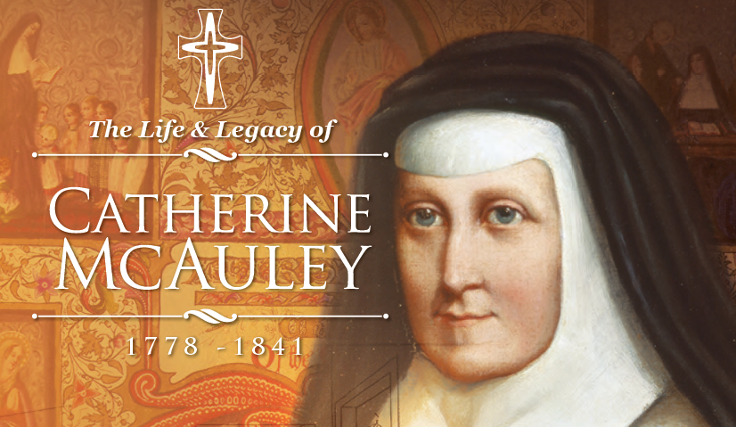

Slide 2
Biography
Born: in 1778
In 1827 she established the House of Mercy in Dublin, Ireland, to shelter homeless women, reach out to sick and dying, educate the poor
Founded the Sisters of Mercy in 1831
Died: 1841

Slide 3
Beliefs About Education
Education empowers people
Students learn from the example set by their teachers
Religious instruction was also important – focussing on FAITH, HOPE and LOVE.

Slide 4
Her Legacy (what has she left behind?)
Today there are:
Mercy Sisters who work in over 30 countries world wide
They work in education, health care, welfare, provide religious support and run environmental programs.

Slide 5
McAuley Prayer
Lord,
Venerable Catherine McAuley had deep faith in You
And used her resources to address the poverty and injustices she saw around her.
Just like Catherine, stir in us, the gift of love.
Give us wisdom to see those who need our help,
Give us understanding to hear the voices of those who are disadvantaged
Give us courage and strength to walk the path of justice and integrity
Lord, help us to continue the work that Catherine began all those years ago.
Amen

