Slide 1
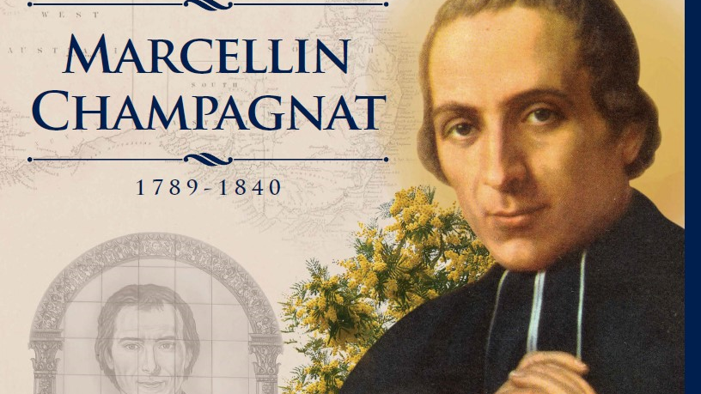

Slide 2
Biography
20 May 1789
Born: 20 May 1789 at Le Rosey in France,
22 July 1816
Ordained as a priest
2 Jan. 1817
Established Marist Brothers’ Order
6 June 1840
Died
18 Apr. 1955
Canonised (became a saint)
6 June
Feast Day

Slide 3
The Marist Brothers & Our lady of mercy college
When Champagnat became a priest, he began working in La Valla, teaching Religion and celebrating masses.
He wanted to create a religious order of men, who would teach and work with the poor – this was established in 1817 and they were called the Marist Brothers. A lot of people made fun of him for doing this.
The brothers made iron nails to earn money.
As more men joined the Marist Brothers, they need to build a larger space to live – this was called Our Lady of the Hermitage.
Since then, the Marist Brothers have spread worldwide, establishing schools and helping the poor.
In 1954, built St Francis Xavier’s Boy School in Bunbury.
In 1973 it joined with St Josephs School to become Bunbury Catholic College (BCC).
In 2015, the Mercy Campus of BCC was built.
2020 – we became Our Lady of Mercy College.

Slide 4
Achievements & Attributes
Achievements | Attributes
Established the Marist Brothers | Faith filled
Built Our Lady of the Hermitage | Courageous
Established many schools | Tenacious
2024 – there are 6000 schools 5000 brothers across 76 countries | Persistent
 | Resilient

Slide 5
Prayer
Dear Lord
We give thanks to You
For the inspiration and faith of St Marcellin Champagnat
who brought the love of Jesus and Mary into the lives of young people.
Help us, like St Marcellin, to see the dignity in the people we meet every day.

Slide 6
May we display integrity by remaining loyal to our friends,
and being faithful companions to others.
And may we follow Marcellin’s example by showing tenacity when facing challenges in our lives.
We ask this through Christ our Lord
Amen

